Slide 1
Markov Model
Dr. Mrunal Rane

Slide 2
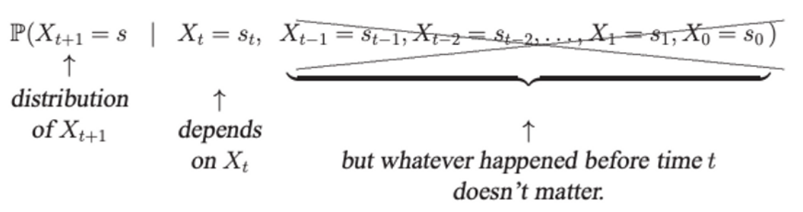
Markov Model
A Markov model is a stochastic method for randomly changing systems that possess the Markov property.
Markov Property: at any given time, the next state is only dependent on the current state and is independent of anything in the past. This is a form of “memorylessness”.

Slide 3
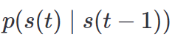
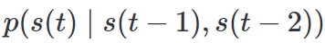
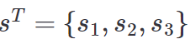
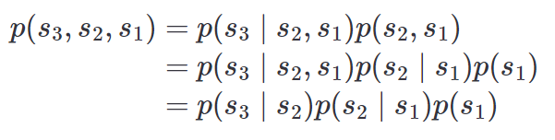
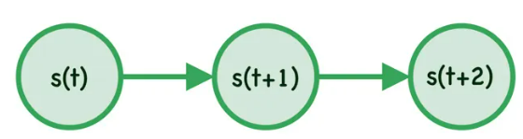
MM
First Order MM
Second Order MM

Slide 4
Types of Markov Model
Markov chains. A sequence of random variables where the distribution of each variable follows a Markov assumption. These are the simplest type of Markov model and are used to represent systems where all states are observable. Applications of this type of model include prediction of market crashes, speech recognition and search engine algorithms.
Hidden Markov models. These are used to represent systems with some unobservable states. In addition to showing states and transition rates, hidden Markov models also represent observations and observation likelihoods for each state. Hidden Markov models are used for a range of applications, including thermodynamics, finance and pattern recognition.

Slide 5
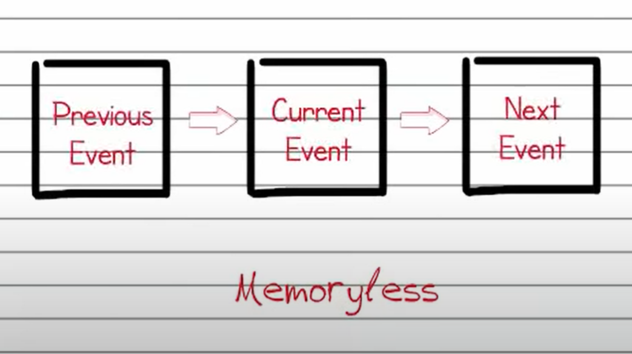
Markov Process

Slide 6
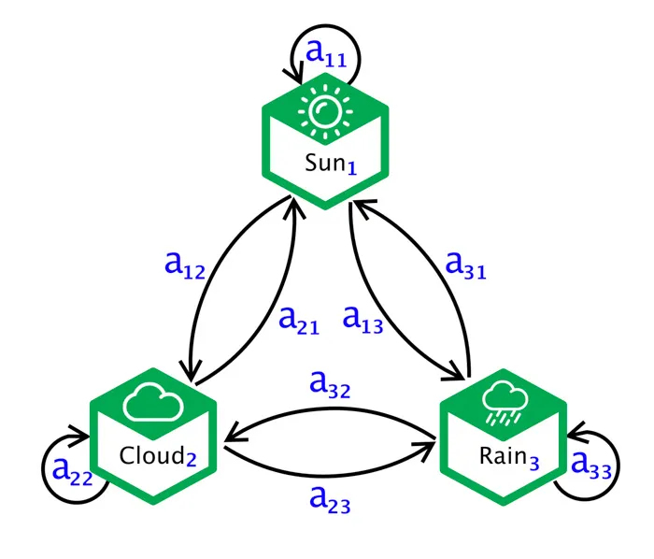
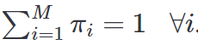
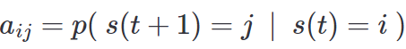
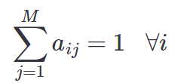
Markov Chain
Initial state:
This is the prob. Dist. over the states at the initial time.
It sets the starting point for the Markov process.
Transition dynamics:
Transition Probabilities:
Each State transition has a specific probability- qualifying the likelihood of moving from me state to another
Steady Sate analysis:
Over time, some Markov models reach a steady state where the state probabilities stabilize .
Notes:
Markov chains, named after Andrey Markov, are mathematical systems that jump from one "state" (a situation or set of values) to another. For example, if you do a Markov chain model of a baby's routine, you might add "playing," "eating", "sleeping," and "crying" as states, which together with other routines could form a 'state space': a list of all possible states. In addition, on top of the state space, a Markov chain represents the probability of hopping, or "transitioning," from one state to any other state---e.g., the chance that a baby currently playing will fall asleep in the next five minutes without crying first.

Slide 7
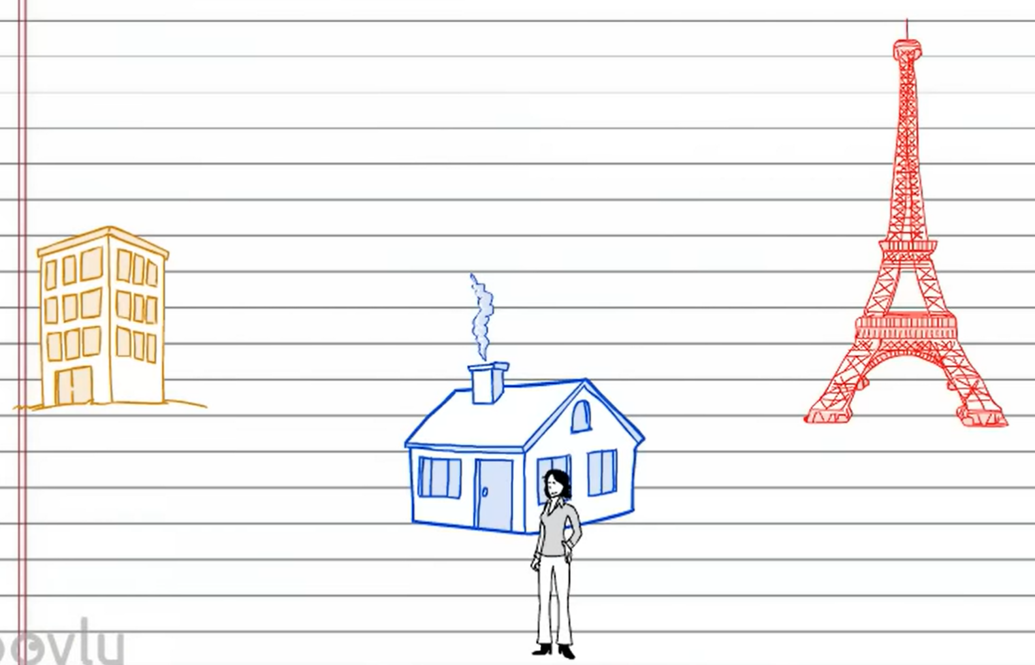
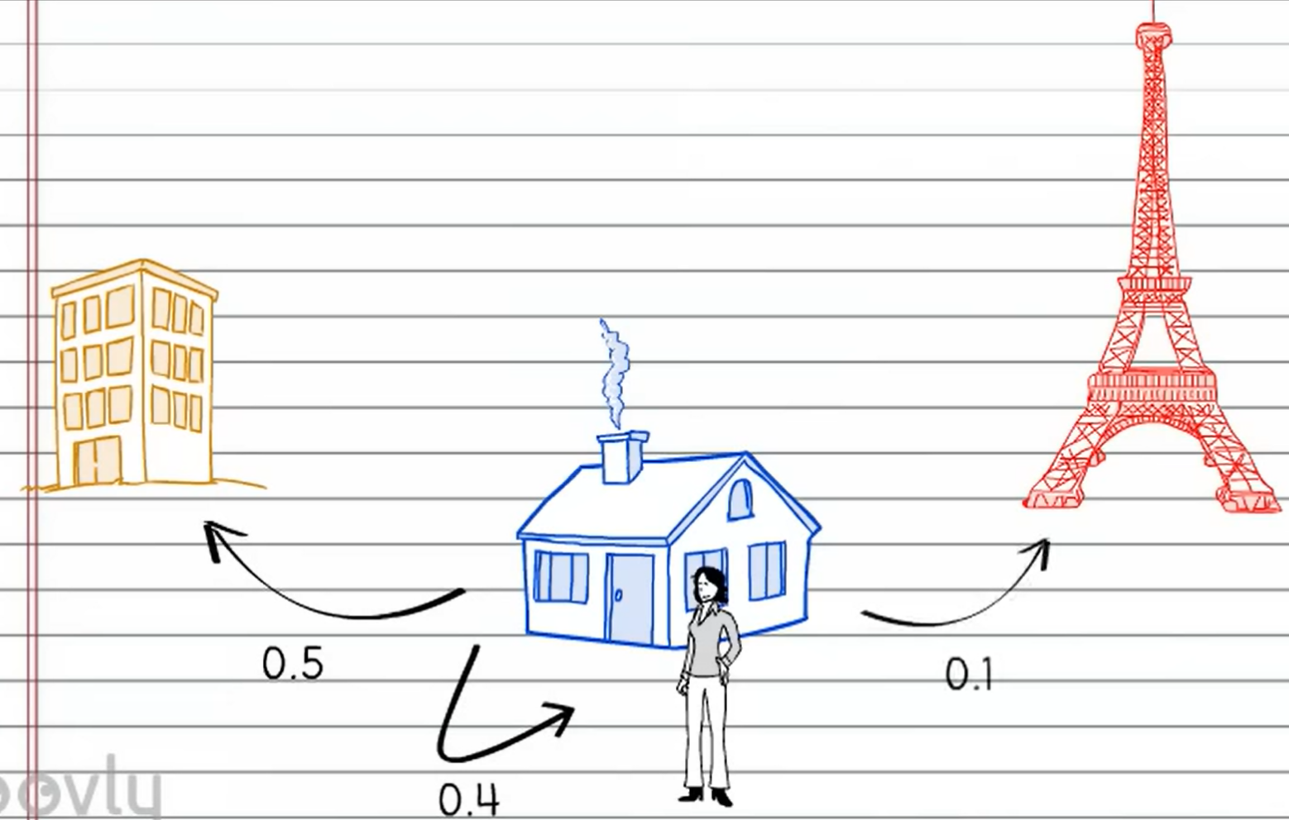
Markov Model

Slide 8
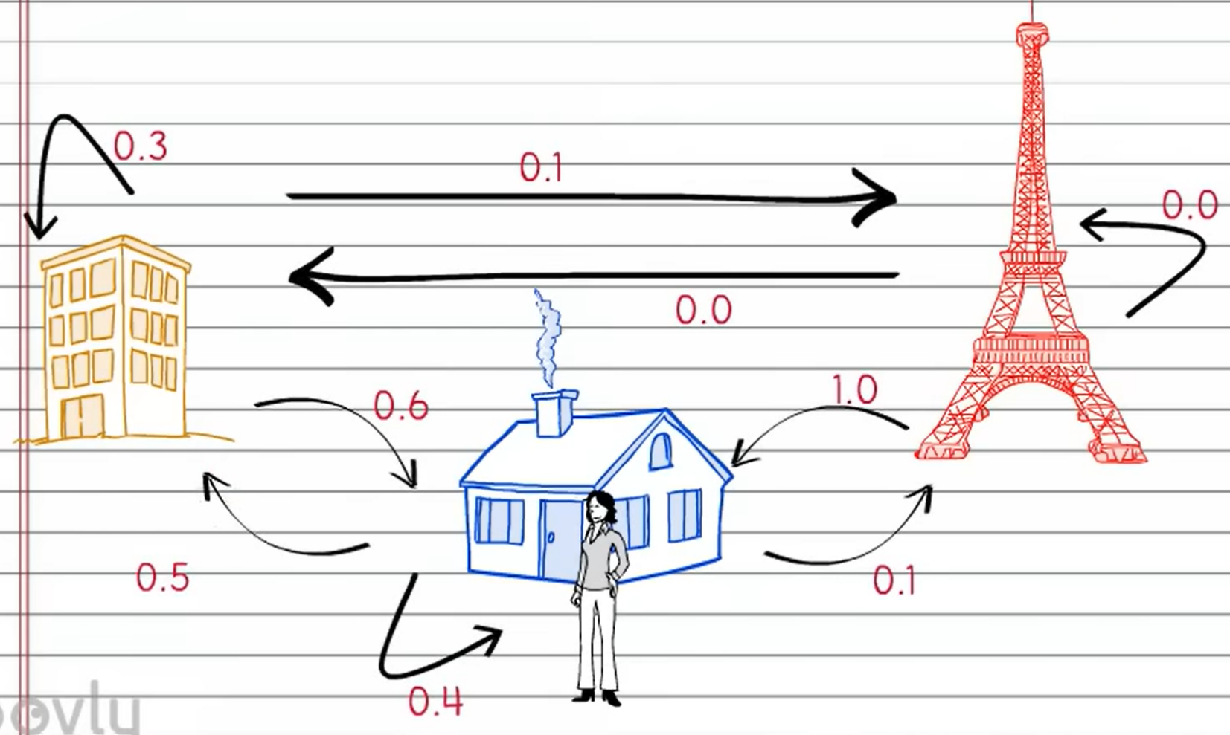

Slide 9
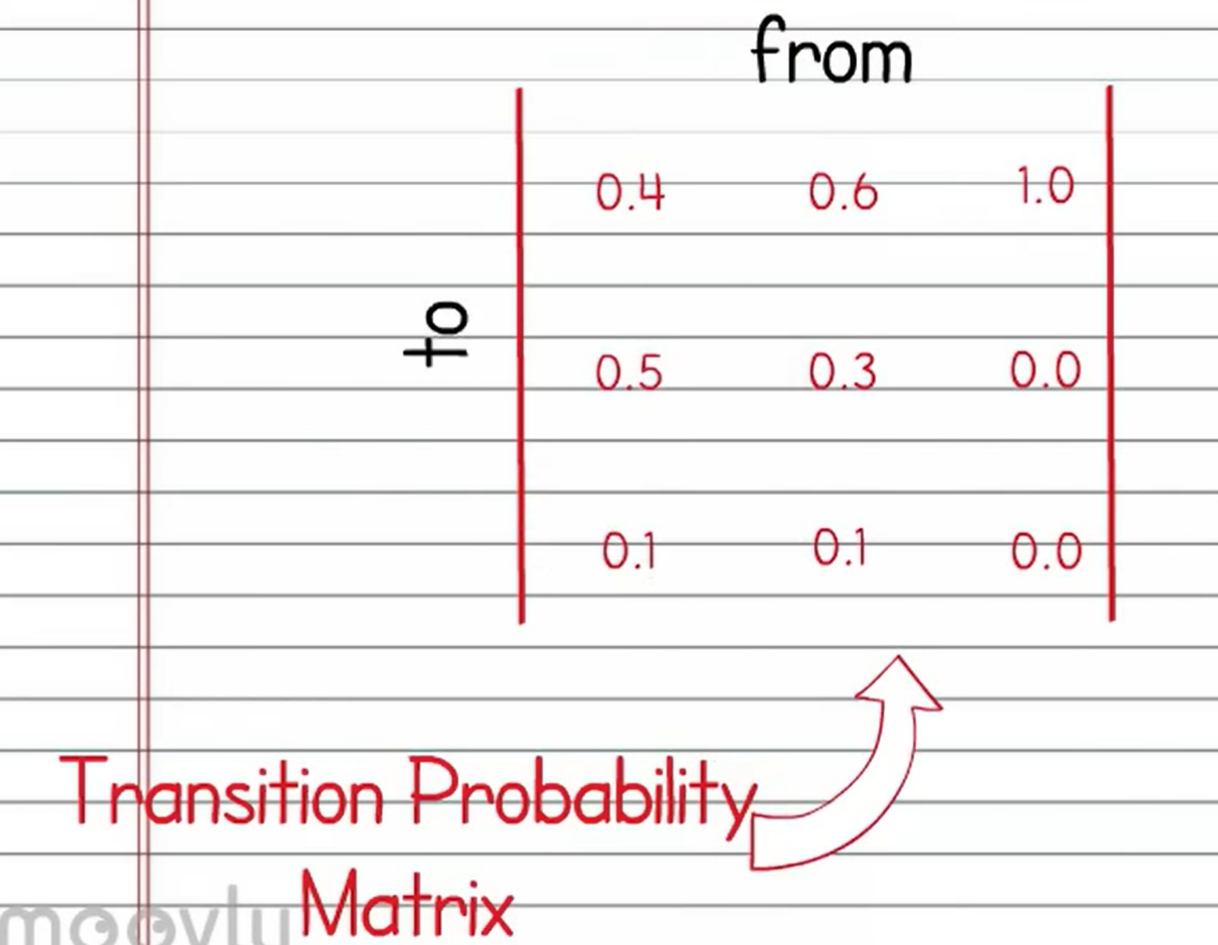

Slide 10
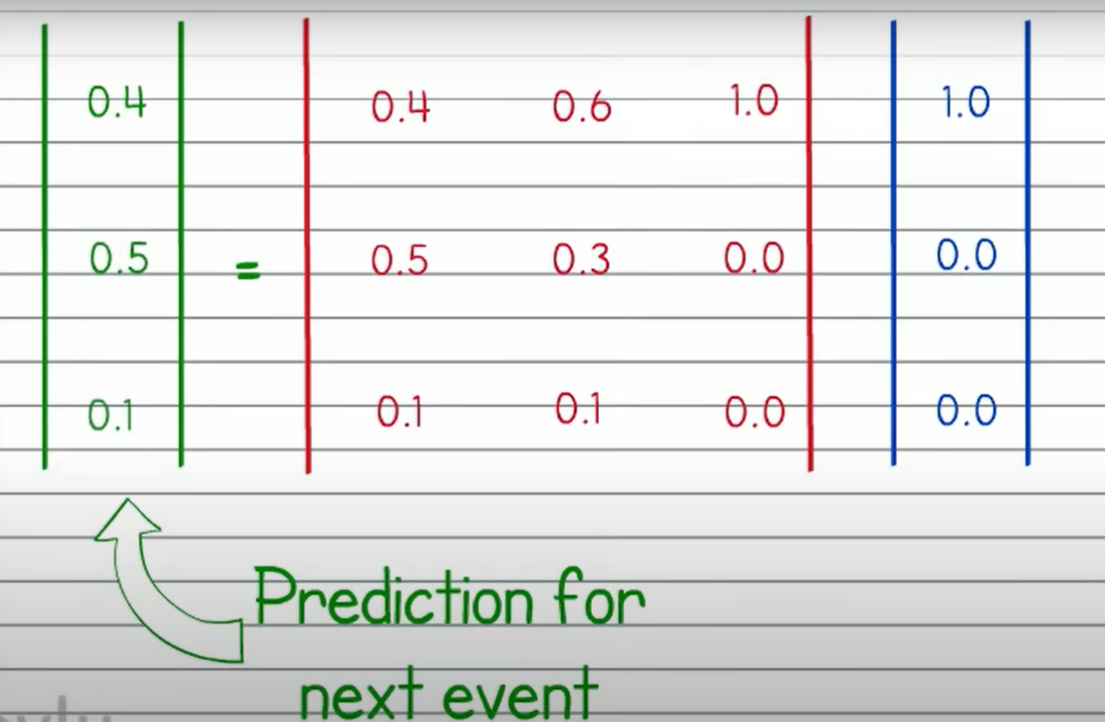
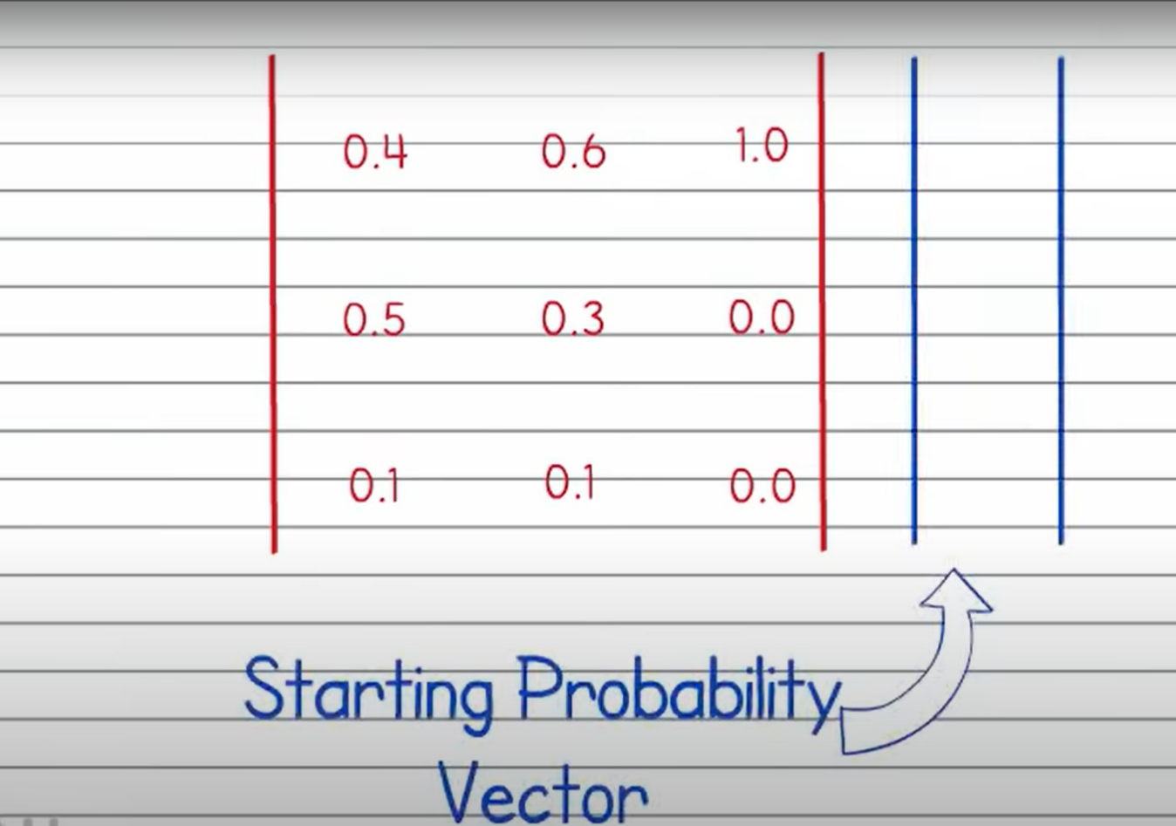
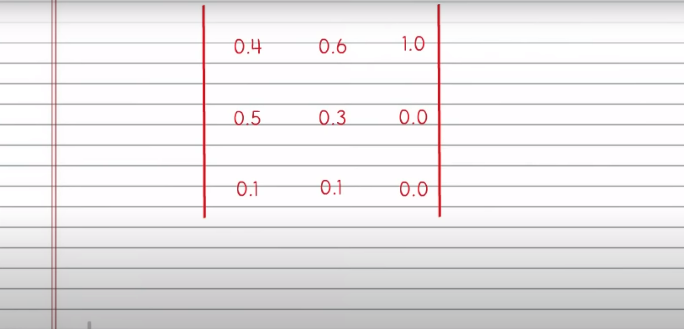

Slide 11
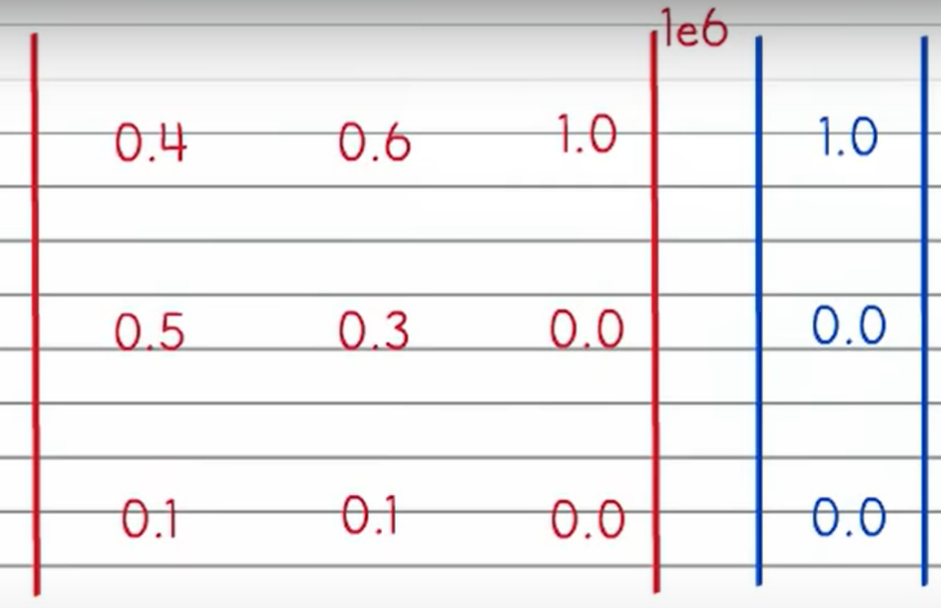
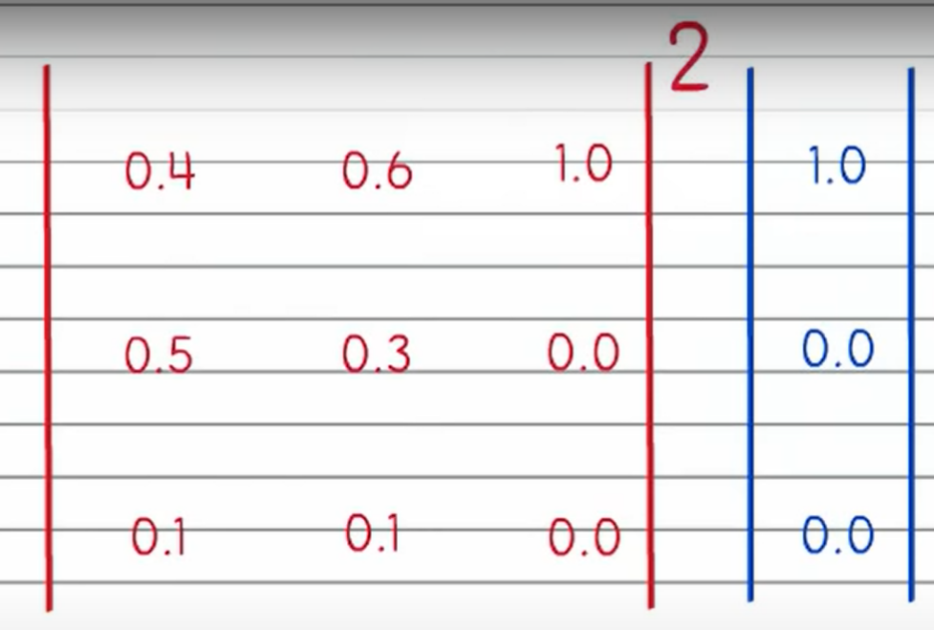
Steady state

Slide 12
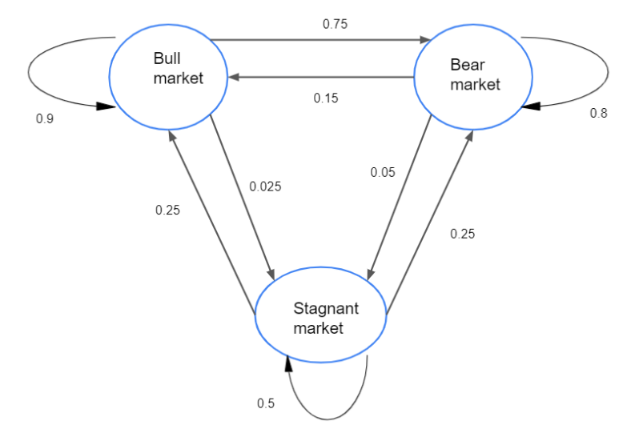
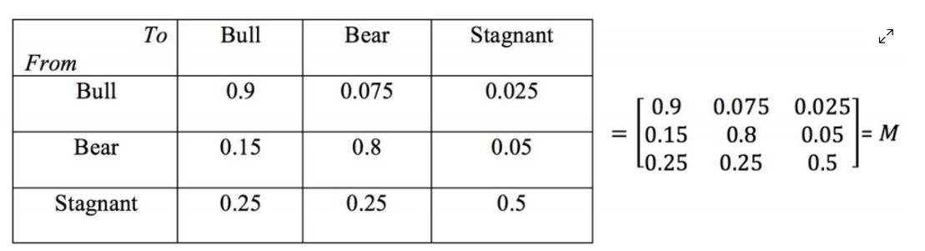
State transition diagram and matrix
0.075
set the current week as bearish, vector C = [0 1 0]

Slide 13
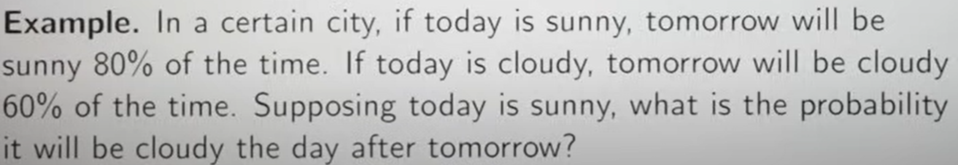

Slide 14
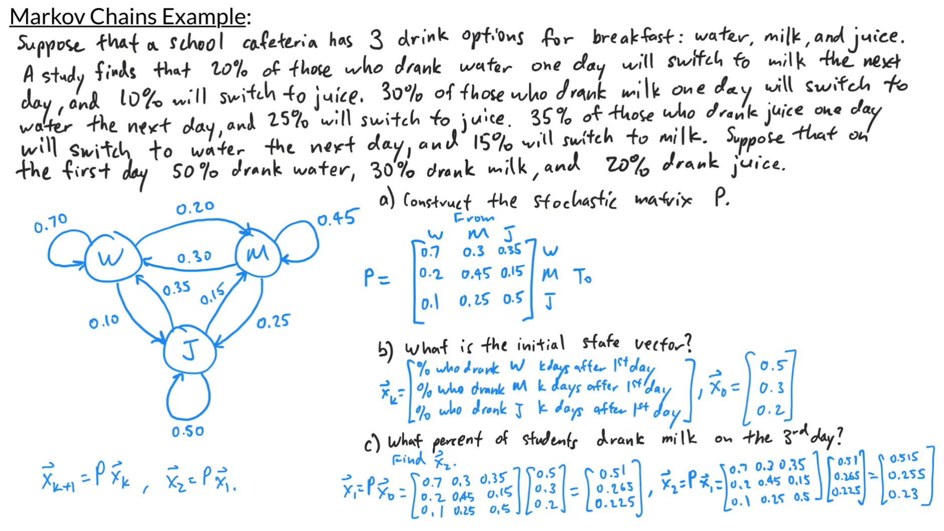

Slide 15
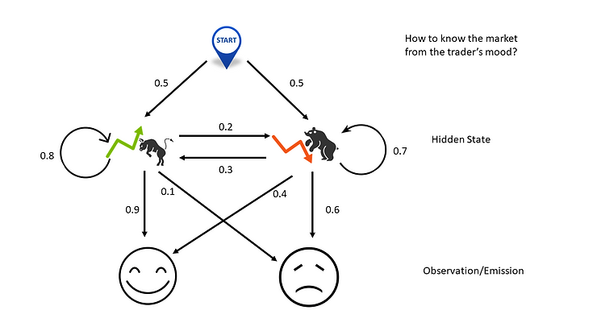
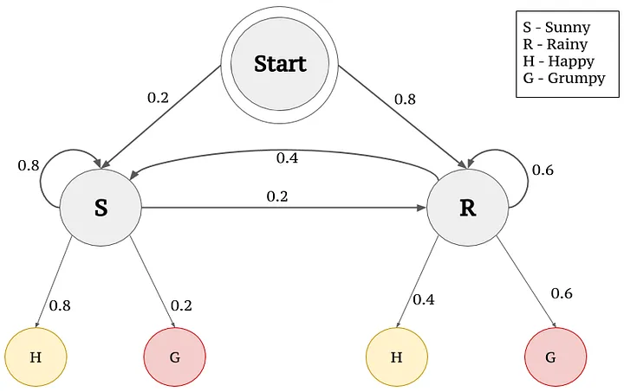
Hidden Markov Model
Hidden States: The actual locations of the animal (e.g., forest, river, cave).
Observable States: The evidence or observations collected (e.g., footprints, sensor data).
Transition and Emission Probabilities: Probabilities of moving between hidden states and probabilities of an observable state given a hidden state.

Slide 16
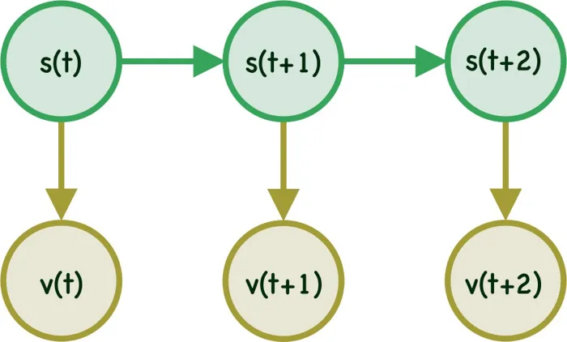
Hidden Markov Model
In Hidden Markov Model the state of the system will be hidden (unknown), however at every time step t the system in state s(t) will emit an observable/visible symbol v(t).

Slide 17
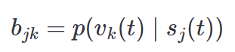
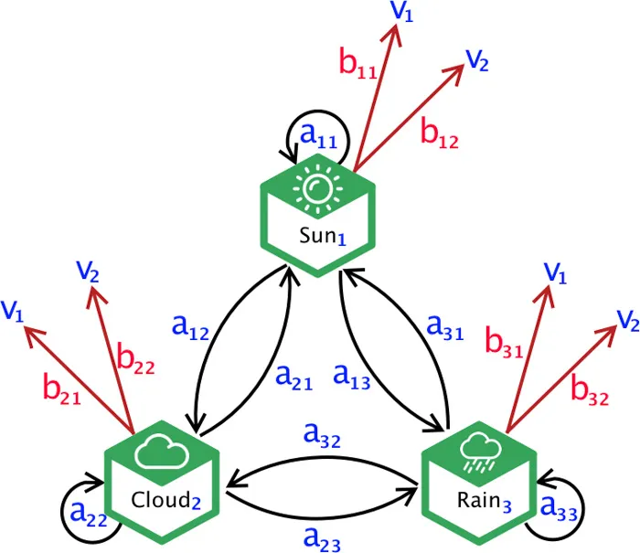
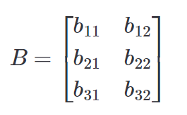
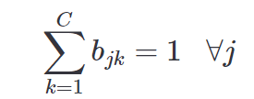
Emission Probability
the probability of emitting symbol k given state j

Slide 18
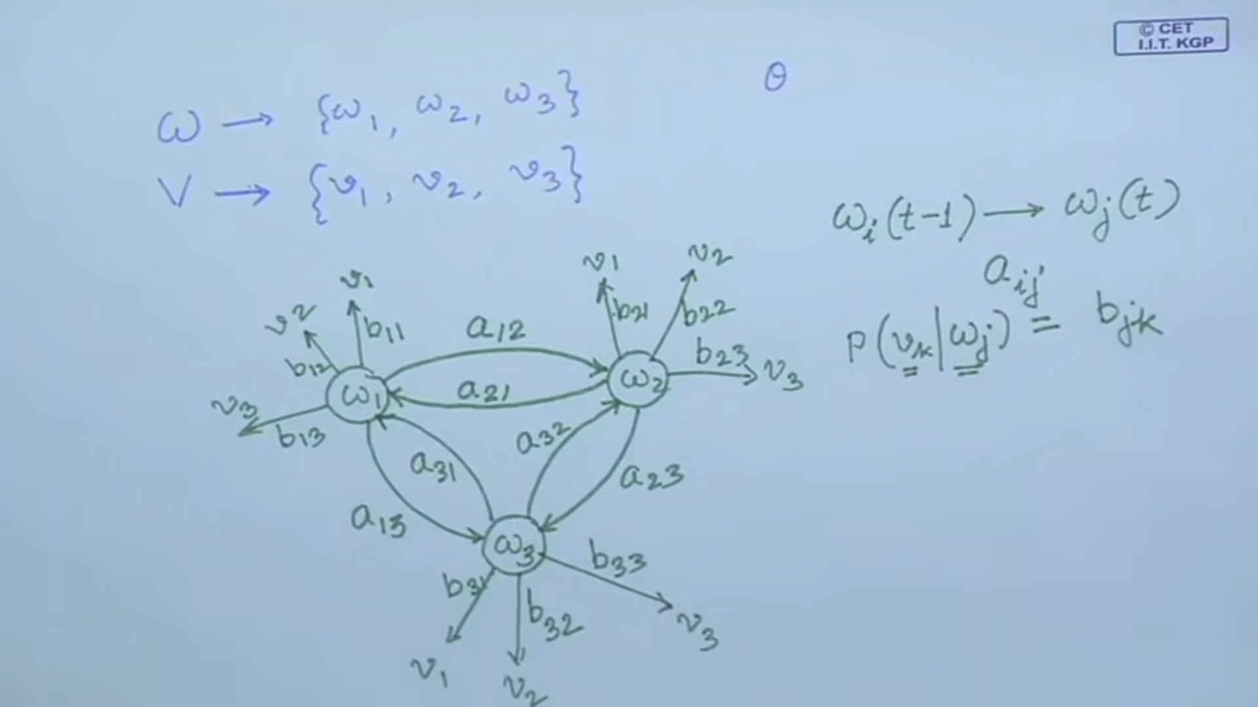

Slide 19
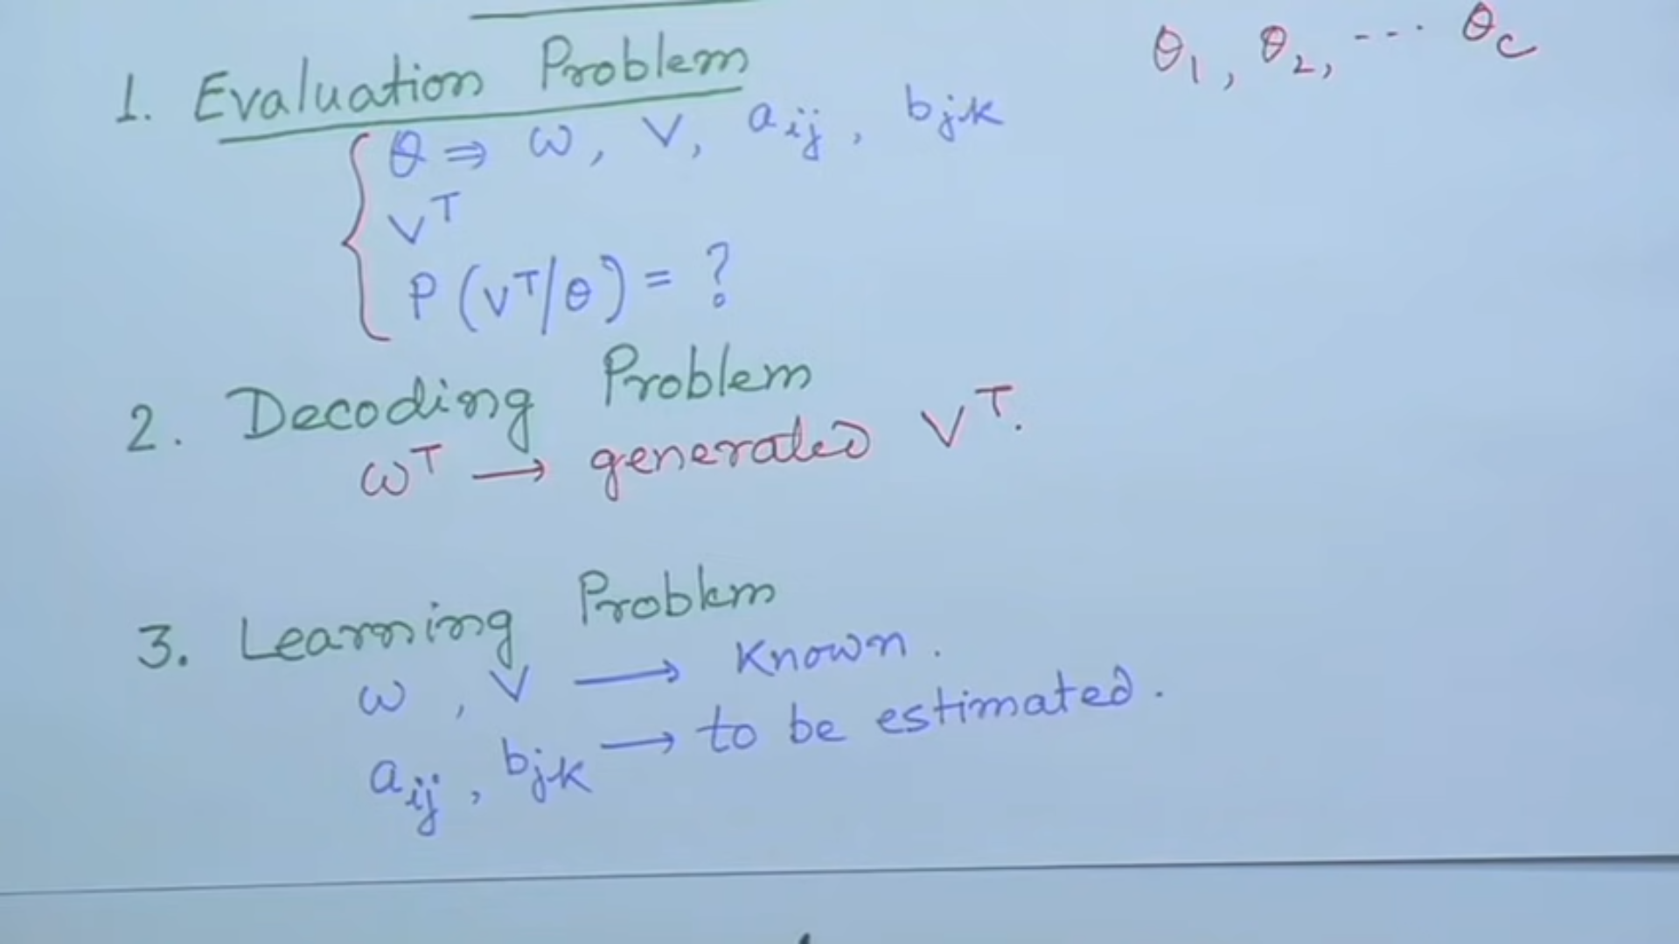
Central Issues in HMM

Slide 20
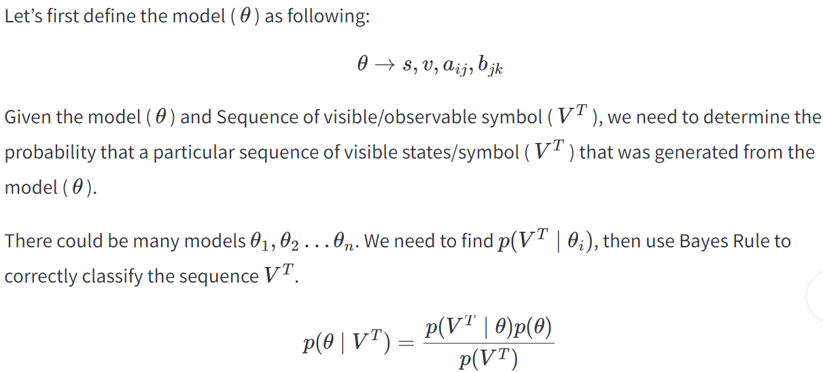
Evaluation Problem

Slide 21
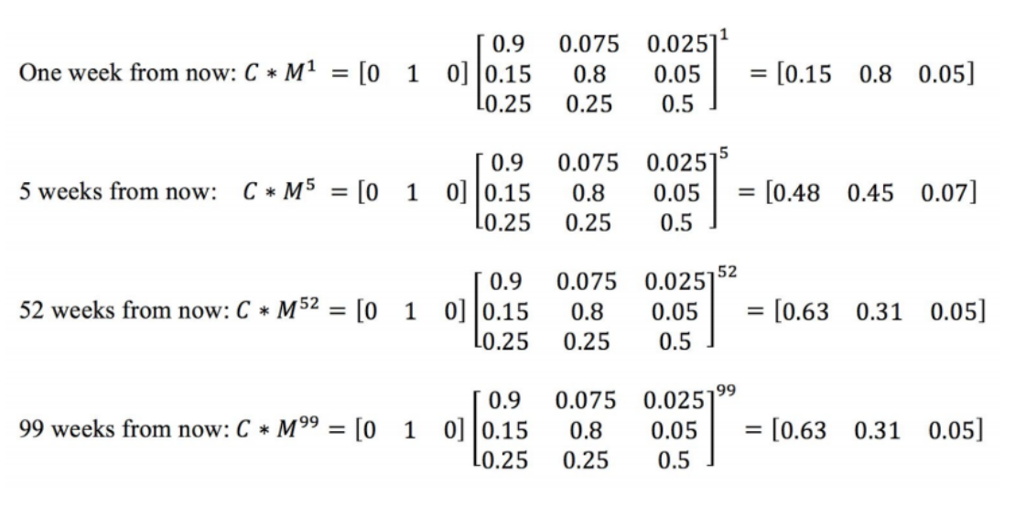

Slide 22
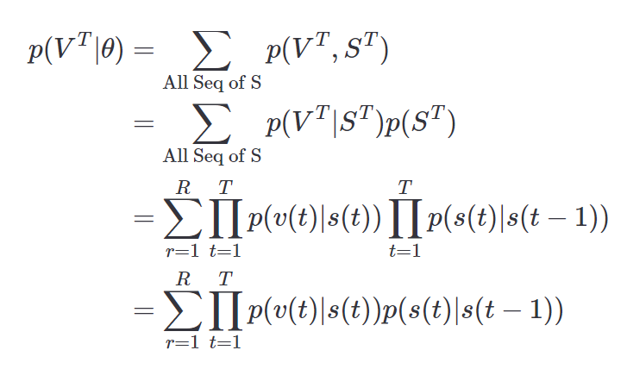
Evaluation
R =Maximum Number of possible sequences of the hidden state.

Slide 23
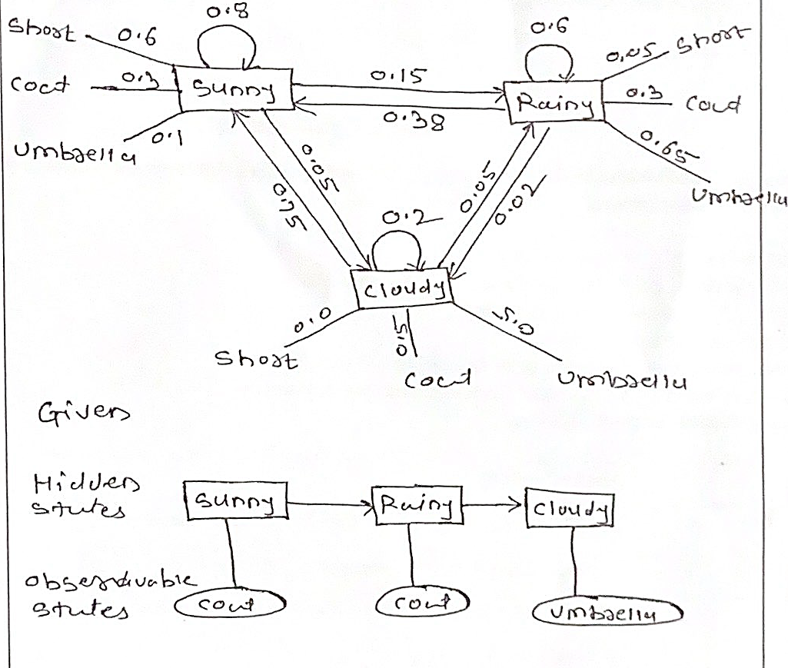
Example

Slide 24
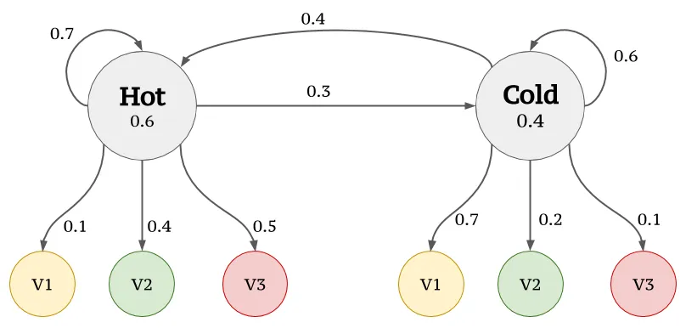
Example

Slide 25
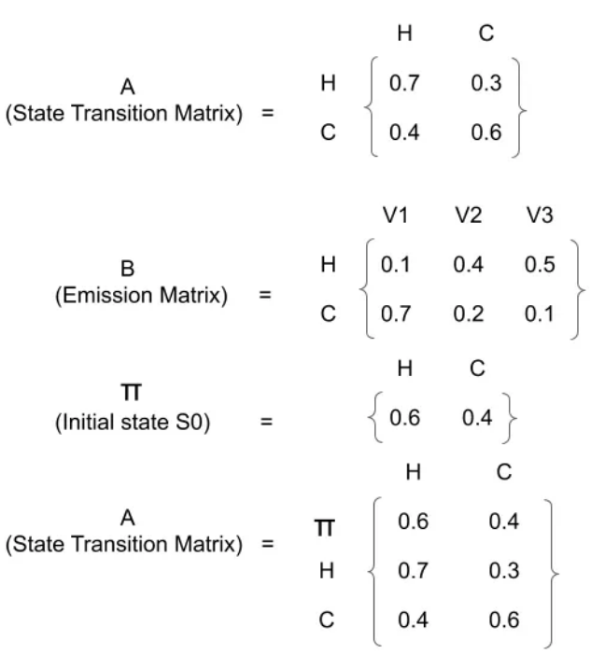
?
?
?
1
3
1

Slide 26
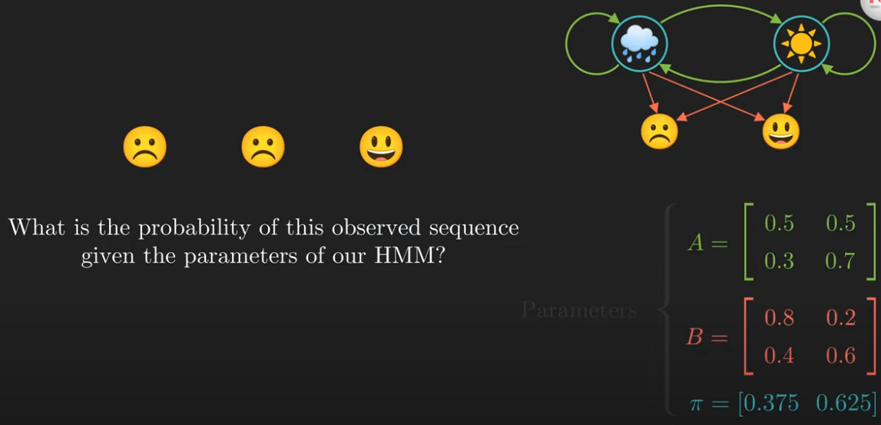
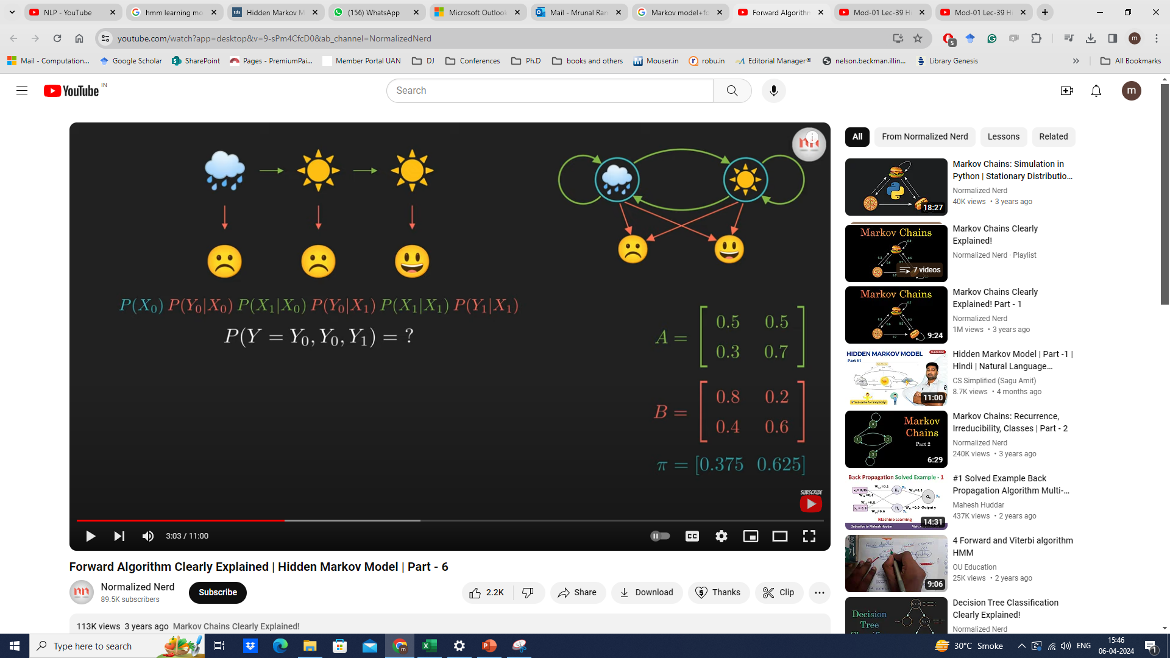
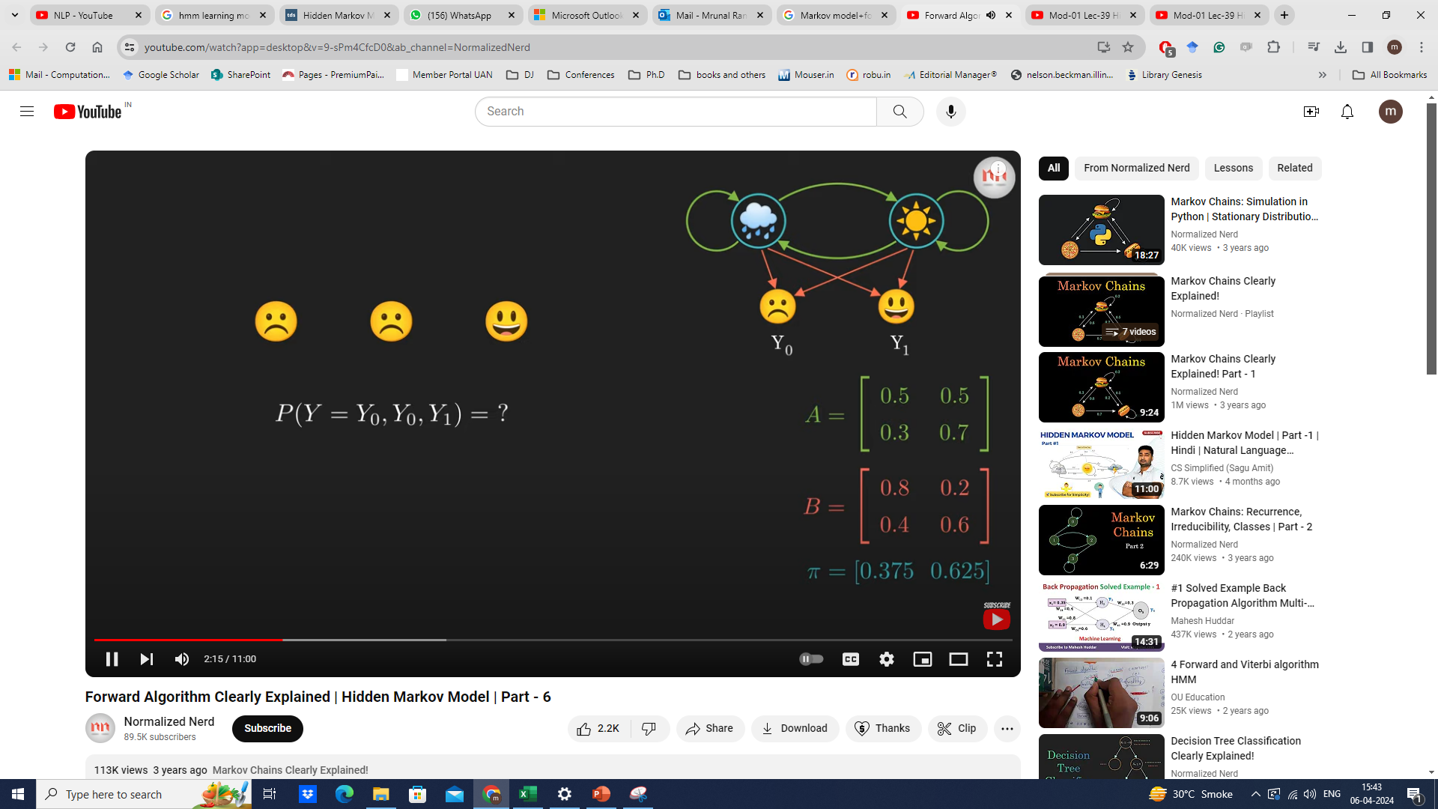

Slide 27
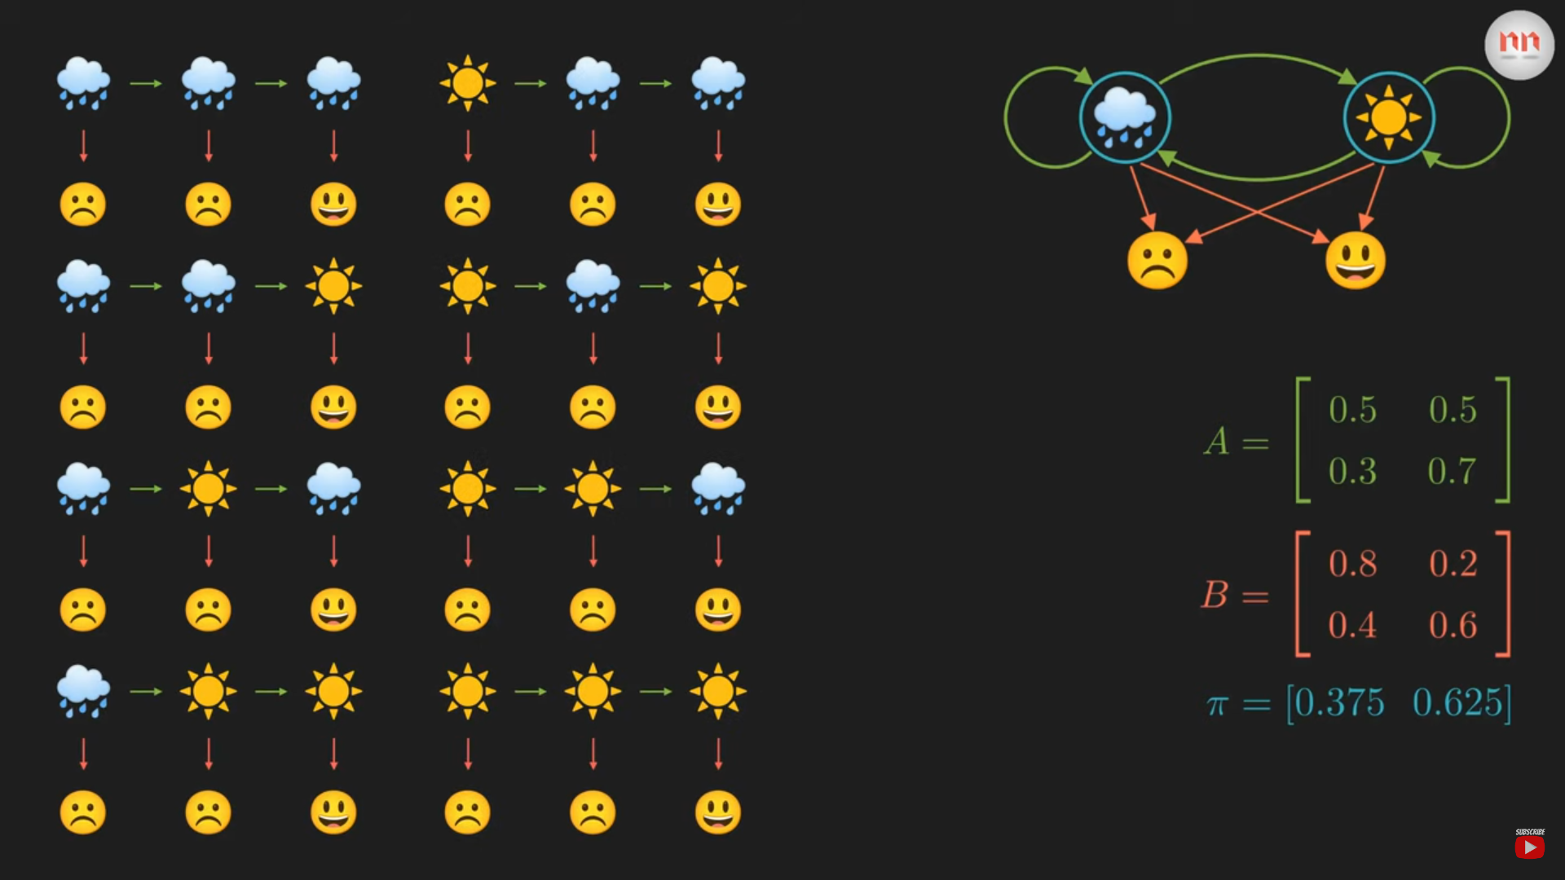

Slide 28
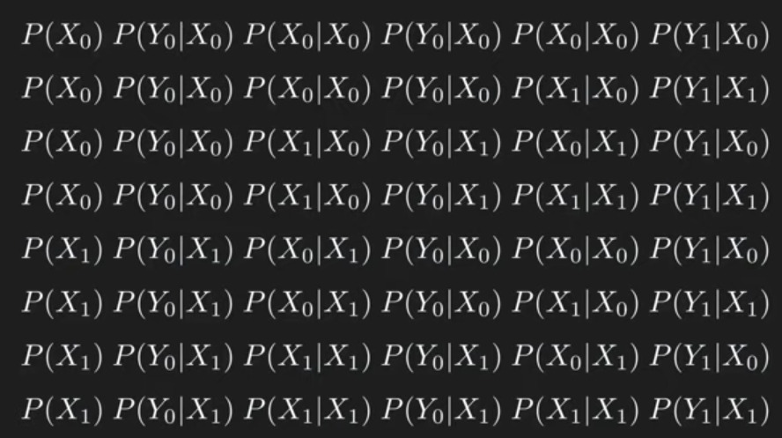

Slide 29
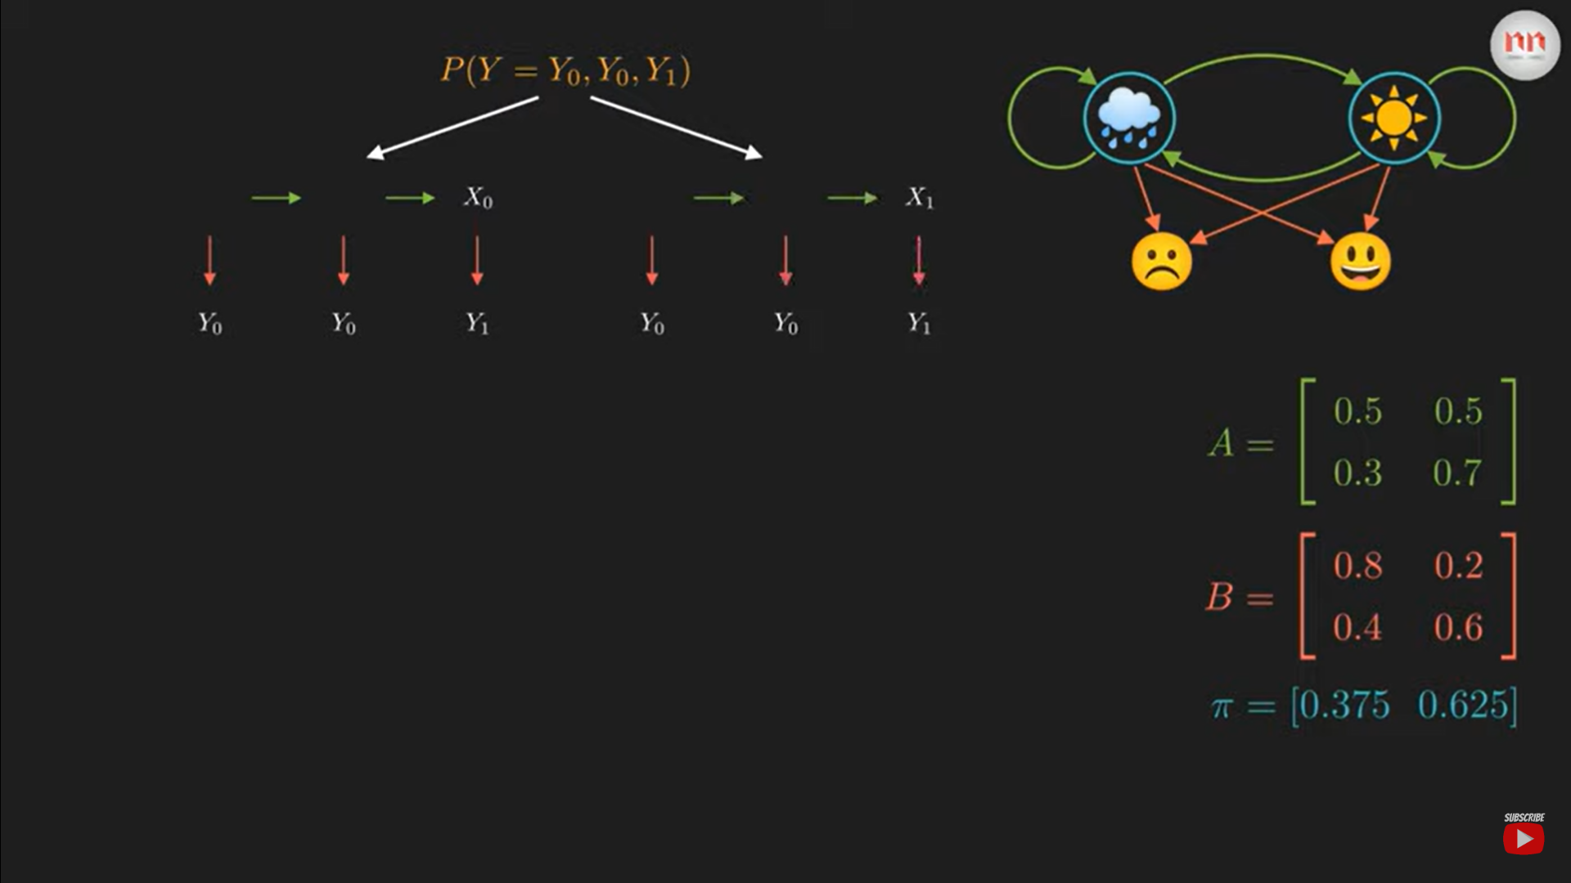
Recursive dynamic programming - Forward

Slide 30
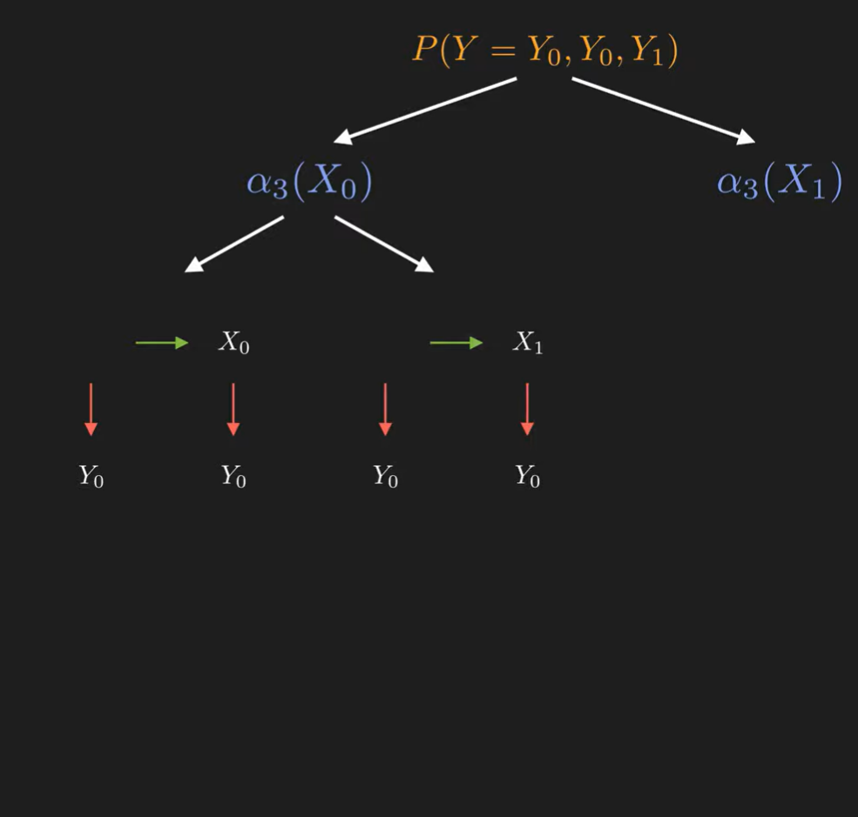
Recursive dynamic programming - Forward

Slide 31
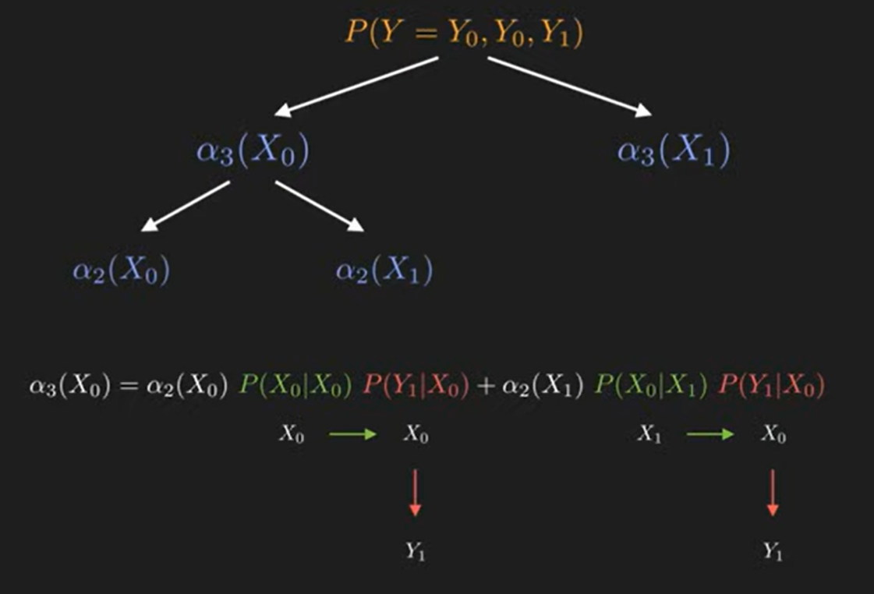
Recursive dynamic programming - Forward

Slide 32
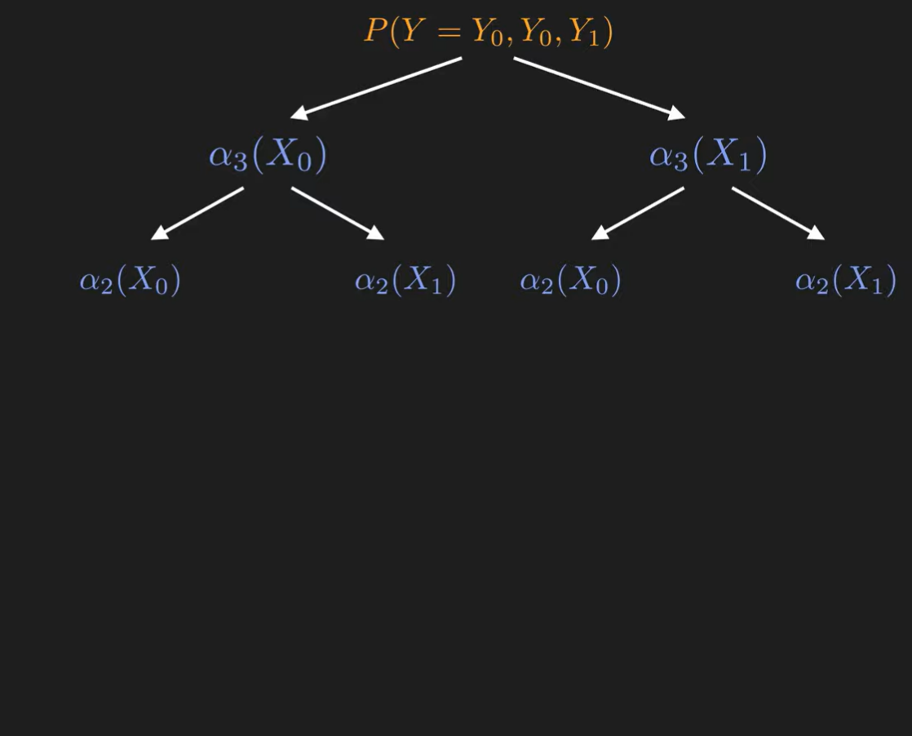

Slide 33
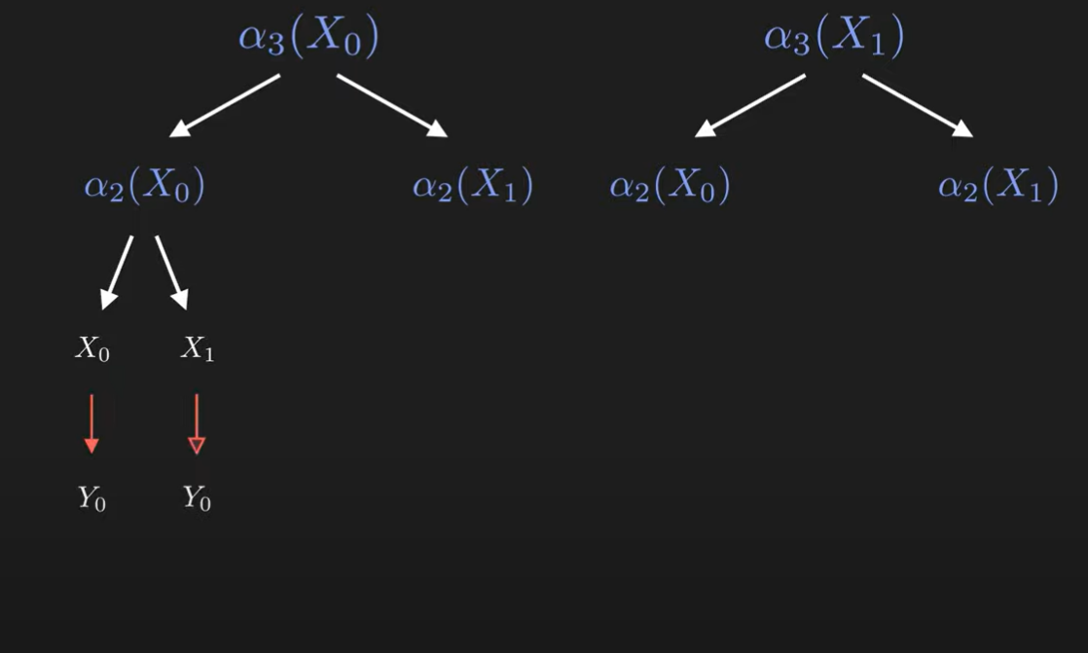

Slide 34
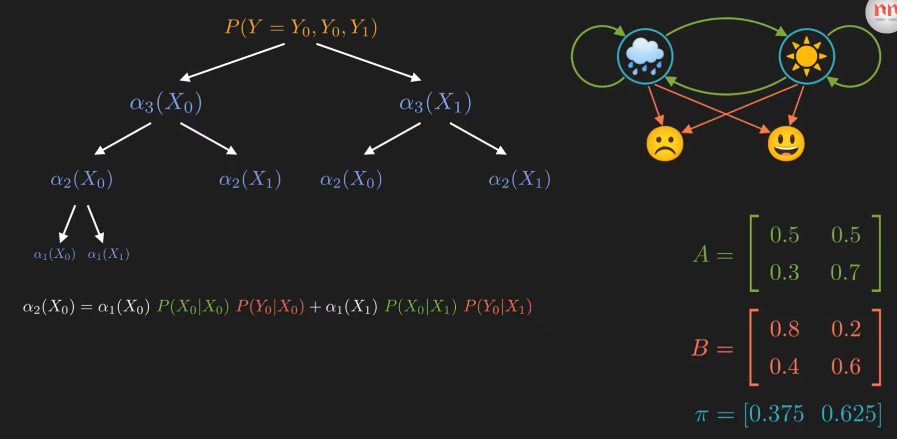



Slide 35


Slide 36






Slide 37


Slide 38



Slide 39


Slide 40
Applications
1. Epidemiology
Markov models are crucial in modeling the spread of diseases, where states can represent different stages of infection or recovery.
2. Customer Behavior Analysis
In marketing, Markov models analyze customer behavior patterns, predicting future purchases based on current activity.
3. Game Theory and Sports
They are used in strategic game scenarios and sports, predicting player or team behavior based on current game states.
4. Environmental Science
Markov models aid in predicting changes in ecosystems or environmental conditions over time.

Slide 41
https://adeveloperdiary.com/data-science/machine-learning/forward-and-backward-algorithm-in-hidden-markov-model/

